Slide 1
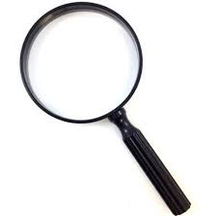
Is science objective?
measure/quantify
control for variables
reproducible
seeks to capture truth and reality
Our backgrounds and identities influence the science we do
Co-opting “objectivity” to justify white supremacy
Historical ways of thinking influence what questions are asked and what is observed
Categorical, binary, either/or thinking
Notes:
Slide 1: This presentation is about how science is influenced by who is doing the science. We’ll start with a question: is science objective? “Objective” in the sense that science is completely divorced from the scientist. There are many processes in place to try to ensure this is the case. We focus on measuring, quantifying, and analyzing data, controlling for any confounding variables. We try to make our science reproducible, so that anyone can repeat our study and come to the same conclusions. And one of the ultimate goals of science is to describe the truth and reality of the natural world.
But in this lecture we will see how our backgrounds and identities influence the science we do. The first two examples are about scientific racism, which co-opts the idea that science is objective to justify hateful ideas. Then there are several examples of ways in which historical ways of thinking have influenced what questions are asked and what is observed, leading to blindspots in our current knowledge of the world. Finally, we will consider how a common mode of thinking in binaries shapes our science.

Slide 2
Scientific Racism: ”co-opting the authority of science as objective knowledge to justify racial inequality” [Harvard library]
Notes:
Slide 2: We will start with two examples of early scientific racism, which can be defined as the co-opting of the authority of science as objective knowledge to justify racial inequality.
Sources:
https://library.harvard.edu/confronting-anti-black-racism/scientific-racism

Slide 3
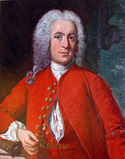
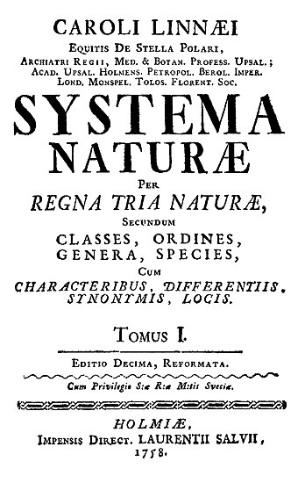
Carl Linnaeus
(1707-1778)
One of the roots of modern scientific racism
Systema Naturae 1735
Classified thousands of specimens
Standardized binomial naming system
Foundation for modern taxonomy
First naturalist to include humans in animal kingdom
https://www.linnean.org/learning/who-was-linnaeus/linnaeus-and-race
Notes:
Slide 3: The first example is Carl Linnaeus, who is one of the roots of modern scientific racism. He’s known for writing Systema Naturae in 1735. At this point in history, naturalists were traveling around the world collecting specimens, but had no way of organizing them or relating them to each other. Linnaeus created an organizational system for classifying specimens that is the foundation of modern taxonomy. He also standardized the binomial naming system we still use today. Notably, he was the first naturalist to include humans in the animal kingdom, right next to apes.
Sources:
https://www.linnean.org/learning/who-was-linnaeus/linnaeus-and-race
https://www.youtube.com/watch?v=kVD6PP61A28

Slide 4
Carl Linnaeus
(1707-1778)
One of the roots of modern scientific racism
Four “varieties” of humans (geography rather than biology)
Europaeus albus: European white
Americanus rubescens: American reddish
Asiaticus fuscus: Asian tawny
Africanus niger: African black
https://www.linnean.org/learning/who-was-linnaeus/linnaeus-and-race
Notes:
Slide 4: In later editions of Systema Naturae, Linnaeus further categorized humans into four “varieties.” These categories were based on geography, with no biological meaning.

Slide 5
Carl Linnaeus
(1707-1778)
One of the roots of modern scientific racism
1750s: added physical/moral attributes
Humours associated with each “variety,” affecting personality and health
Hierarchy
https://www.linnean.org/learning/who-was-linnaeus/linnaeus-and-race
Notes:
Slide 5: Then he went on to ascribe physical and moral attributes to each “variety.” At the time, doctors thought humours, or bodily fluids, affected a person’s personality and health. So Linnaeus attributed a different humour to each “variety,” and used these categories to explain differences in personality, clothing, and form of government. He often listed the varieties in a similar order, implying a hierarchy among the races.
This provides an example of how the authority of being a scientist and publishing science, under the guise of “objectivity,” can perpetuate racist ideas.

Slide 6
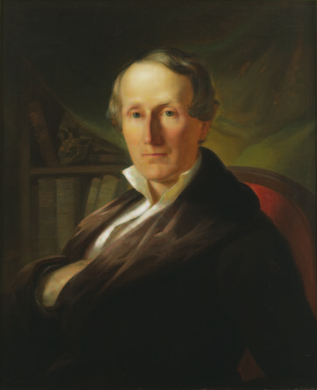
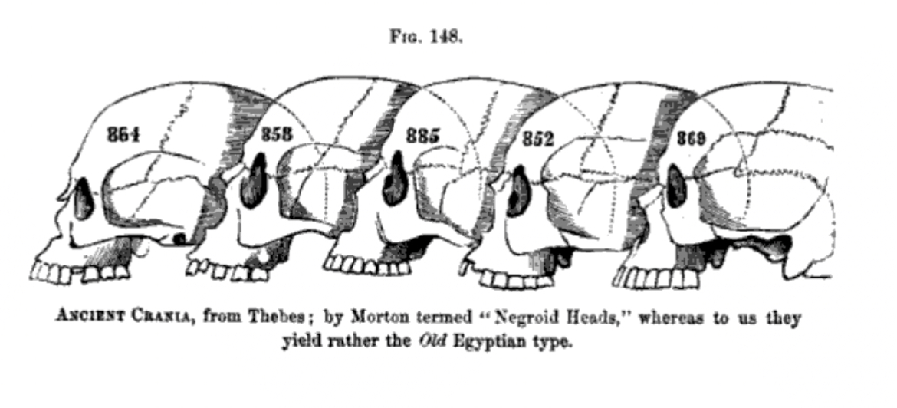
Samuel Morton
(1799-1851)
Collected over 1,000 human skulls, including from enslaved people
Collection of skulls as “evidence” of white superiority
Research on the skulls Morton collected continued at Academy of Natural Sciences and UPenn museum
2021: UPenn promised to repatriate the remains
Notes:
Slide 6: Samuel Morton was a scientist in the early 1800s. He was a craniologist, believing that the volume of a skull related to intelligence. He collected over a thousand skulls, including from enslaved people. He conducted precise measurements of the skulls and used these data as “evidence” of white supremacy. I think this is an important point–he amassed data that probably accurately reflected skull shape and size. But he mis-used this data. First, he made the false assumption that skull size relates to intelligence. Then, he compared mean measurements across races, ignoring immense within-group variation. Possessing “data,” which is supposed to be objective and representative of the truth, can dangerously lead to the espousal of racist ideas that continue for over a hundred years.
Of note: research on the skulls Morton collected continued at the Academy of Natural Sciences and the University of Pennsylvania museum until recently. In the wake of the George Floyd protests in 2020, UPenn promised to repatriate the remains.
Sources:
https://www.learningforjustice.org/magazine/how-samuel-morton-got-it-wrong
https://www.science.org/content/article/racist-scientist-built-collection-human-skulls-should-we-still-study-them

Slide 7
Samuel Morton
(1799-1851)
Premise of objectivity gives a lot of power and authority to science (and pseudoscience)
Notes:
Slide 7: To reiterate, the premise of objectivity gives a lot of power and authority to science (and pseudoscience) that is important to consider and critique.

Slide 8
Notes:
Slide 8: [Pause for reflection, questions, comments.]

Slide 9
Imagine a peacock…
Notes:
Slide 9: Now imagine a peacock…

Slide 10
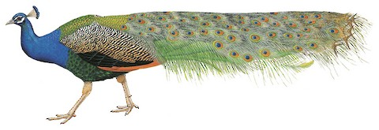
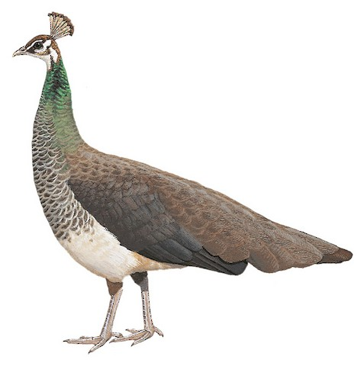
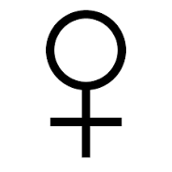
Our thoughts can be influenced by biases–how might that impact our scientific questions and observations?
Notes:
Slide 10: How many of you imagined the peacock on top (the male)? [Most students raise their hands.] This example shows how our thoughts can be influenced by biases–be it a bias towards the charismatic ornamentation of the male’s tail feathers, or a bias towards imagining the male as the archetype of the species. In the next few slides, we’ll see how biases like this have impacted scientific questions and observations.

Slide 11
Because of who has traditionally done science and engrained ways of thinking, we have present-day biases in the science we do
**Lecture is influenced by my own background!—ways for you to contribute
Notes:
Slide 11: The history of who has traditionally done science and engrained ways of thinking have led to present-day biases in the science we do. The examples in this part of the lecture are influenced by my own background. I am an ornithologist, so examples come from that literature. And my identity as a woman in science led me to examples of sex bias in biological research. But I encourage you to think about how any number of identities and backgrounds might affect scientific research.

Slide 12
Because of who has traditionally done science and engrained ways of thinking, we have present-day biases in the science we do
Which animals we study
Notes:
Slide 12: The first example is about how biases have affected which animals we study.

Slide 13
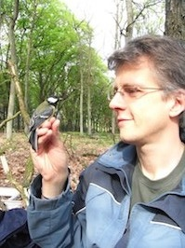
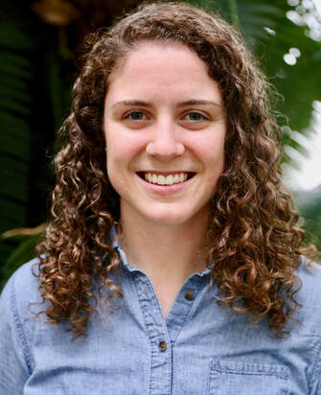
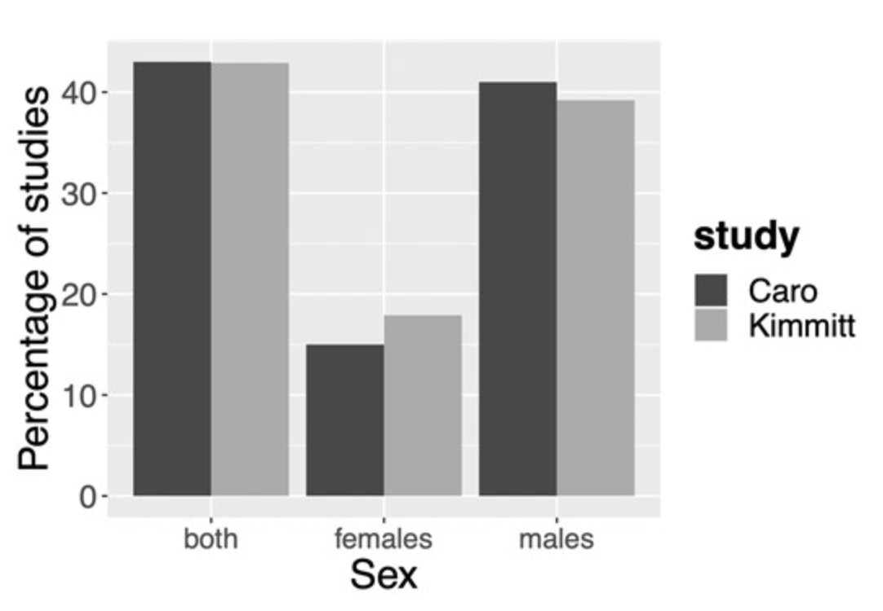
In studies of avian reproductive physiology, males are studied more often than females
Samuel Caro and Abby Kimmitt
(2012)
(2020)
Notes:
Slide 13: In two reviews of studies of avian reproductive physiology, Samuel Caro and Abby Kimmitt found that males are much more often studied than females, and male-only studies are more common than female-only studies. This pattern is similar in biomedical research: male rats have been used in medical research more than females. Female hormones and estrous cycles were thought to be too difficult to control for, so results from all-male studies were extrapolated to both sexes.
Sources:
Caro, SP. 2012. “Avian ecologists and physiologists have different sexual preferences.” General
and Comparative Endocrinology 176(1).
Kimmitt, AA. 2020. “Females as the gatekeepers to seasonal breeding: what we can learn by
studying reproductive mechanisms in both sexes.” Integrative and Comparative Biology 60(3): 703-711.
Beery, AK, and Zucker, I. 2011. “Sex bias in neuroscience and biomedical research.” Neuroscience & Biobehavioral Reviews 35(3): 565-572.
Zucker, I. and Beery, AK. 2010. “Males still dominate animal studies.” Nature 465(690).

Slide 14
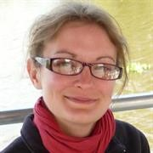
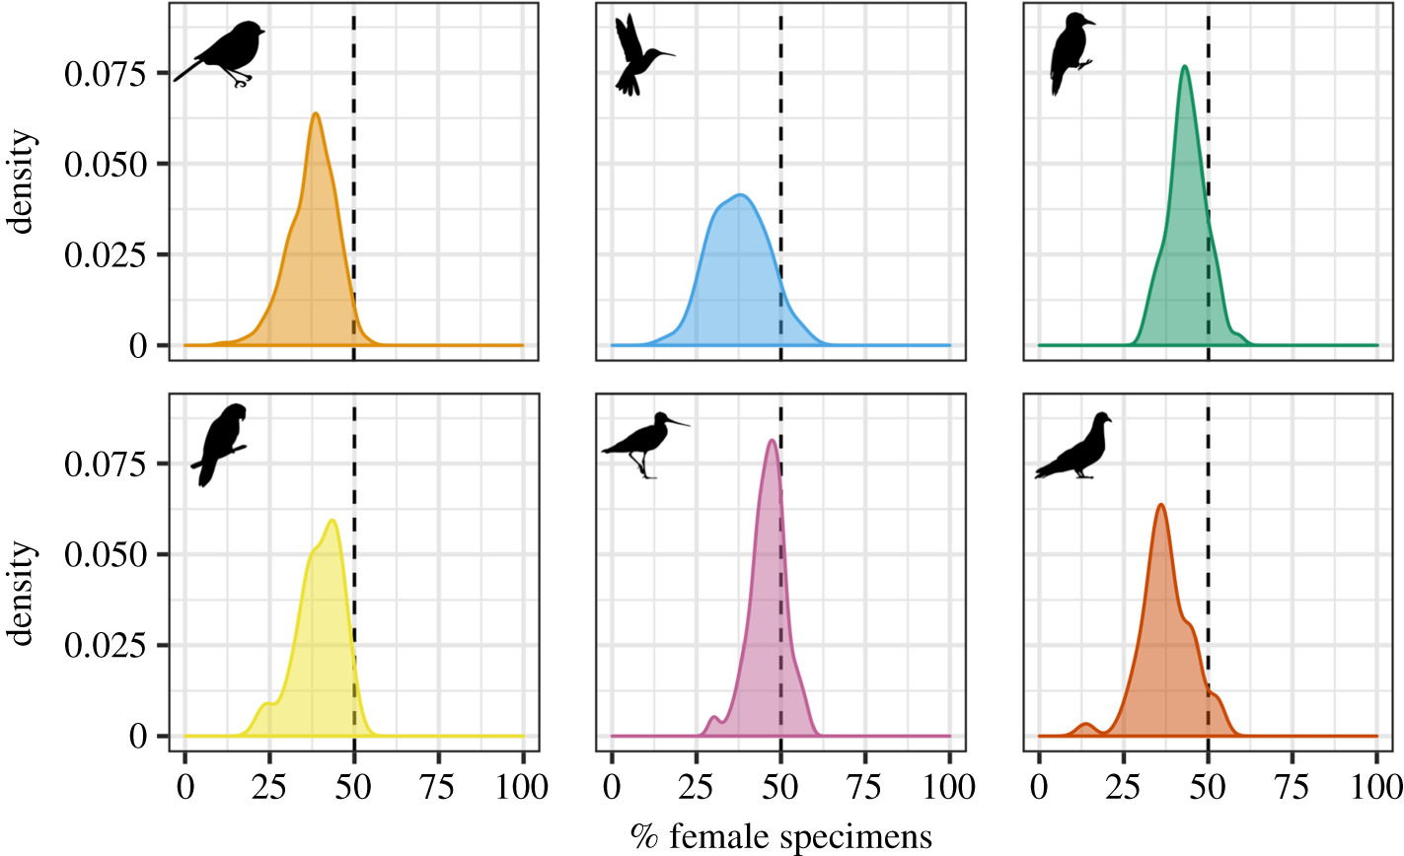
Sex bias in museum specimens,
partly explained by collectors actively seeking more ornamented birds
Natalie Cooper et al. 2019
Notes:
Slide 14: There’s a sex bias in which animals are found in museums. Across six groups of birds, there were generally fewer female specimens than male specimens. This bias could exist for a few reasons: specimen collectors may actively avoid females that are caring for young, or males might be easier to catch. But the authors found that the sex skew is at least partially explained by collectors actively seeking more ornamented birds. You can consider what affect this might have of research using museum specimens if more specimens are representative of males.
Sources:
Cooper, N. et al. 2019. “Sex biases in bird and mammal natural history collections.” Proceedings
of the Royal Society B 286(1913).

Slide 15
Because of who has traditionally done science and engrained ways of thinking, we have present-day biases in the science we do
Which animals we study
Which animals we conserve
Notes:
Slide 15: There can be biases in which animals we conserve.

Slide 16
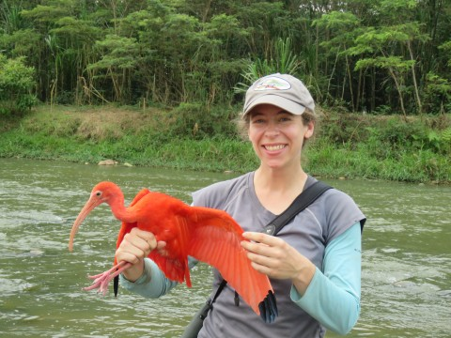
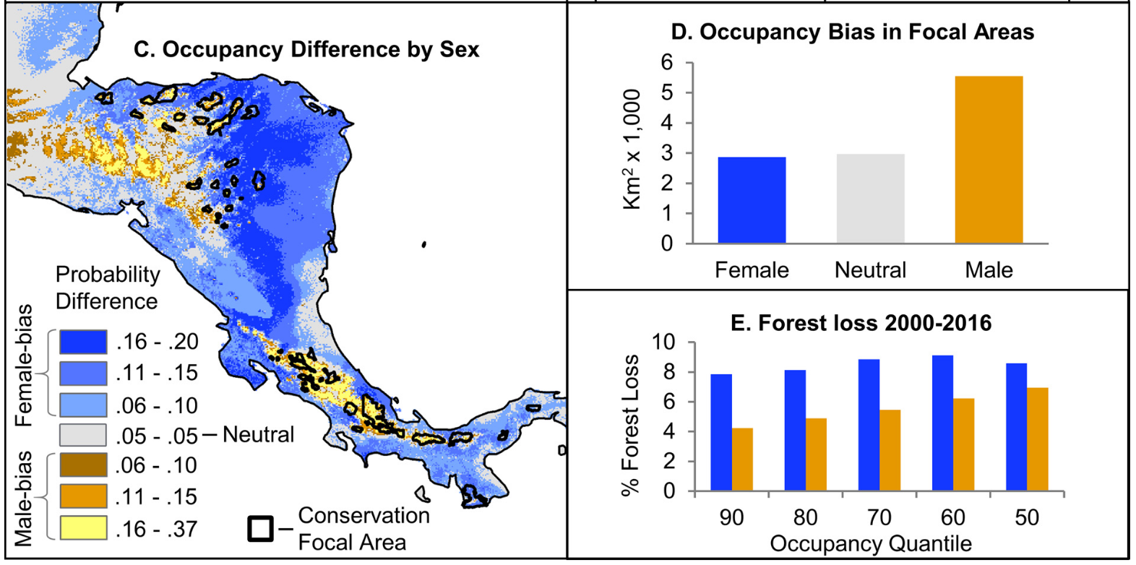
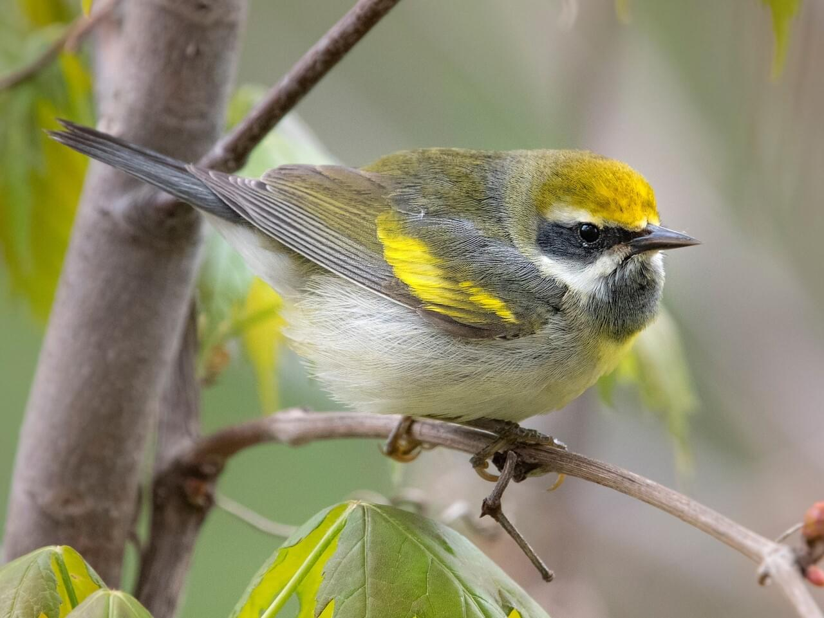
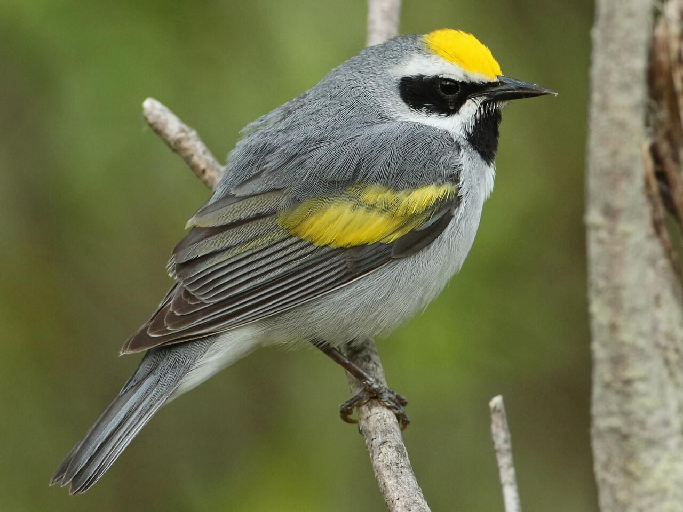
Habitat use often differs by sex (⅓ – ⅔ of North American migratory landbirds)
8% of conservation recommendations consider sexual segregation
Male-dominated habitat thought to be higher quality and of higher conservation value
Ruth Bennett et al. 2019
Notes:
Slide 16: Habitat use often differs by sex. About one- to two-thirds of North American migratory landbirds differentiate habitat use by sex. Yet only 8% of conservation recommendations take this into account. In a case study of golden-winged warblers, Ruth Bennett and her co-authors showed that space use differed by sex in the non-breeding grounds in Central America. Female-dominated habitats are shown in blue; male-dominated habitats are shown in yellow and orange. Black outlines show areas that are the focus of active habitat conservation. The authors found there is marked sex-bias in conserved land: the conservation focal areas are concentrated in male-dominated habitat. And this has consequences for the females: female golden-winged warblers experience about two times as much habitat loss as males.
One reason for this sex bias may be because male-dominated habitat is thought to be higher quality habitat and therefore of higher conservation value. But predominantly conserving that habitat of only one of the sexes can hamper conservation efforts of the species as a whole.
Sources:
Bennett, RE, Rodewald, AD, and Rosenberg, KV. 2019. “Overlooked sexual segregation of habitats exposes female
migratory landbirds to threats.” Biological Conservation 240.

Slide 17
Because of who has traditionally done science and engrained ways of thinking, we have present-day biases in the science we do
What we name animals
Which animals we study
Which animals we conserve
What behaviors we observe
Notes:
Slide 17: Finally, biases can even affect what behaviors we observe.

Slide 18
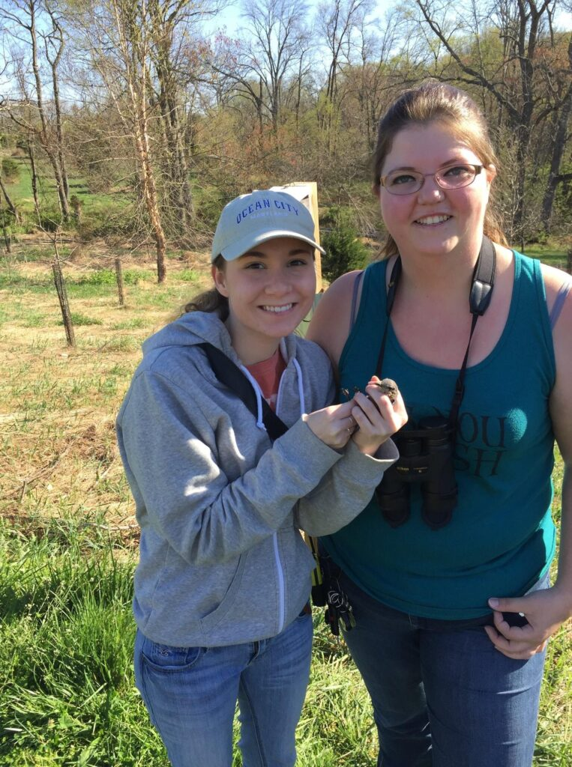
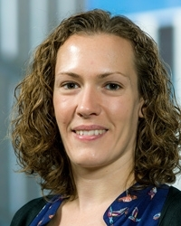
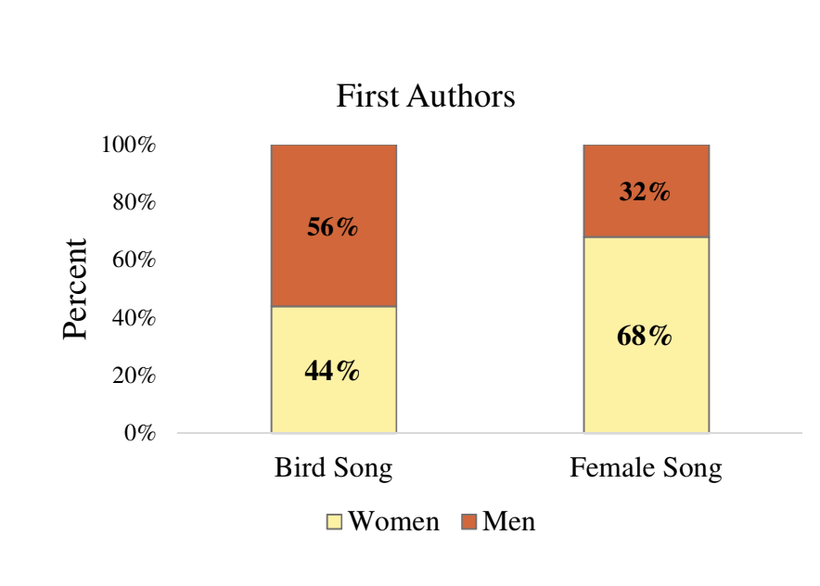
The majority of bird song research has been done under the assumption that songs evolved through sexual selection on males–ignoring female song
Instances of female song thought to be rare, atypical, hormonal aberrations
passive females:
Darwin 1871 The Descent of Man: “The female, though comparatively passive, generally exerts some choice and accepts one male in preference to others.”
north temperate bias
Casey Haines et al. 2020
2014: 2/3 songbird species have female song; song originally evolved in both sexes
Karan Odom et al. 2014
Notes:
Slide 18: The majority of bird song research to date has been done under the assumption that songs evolved through sexual selection on males, ignoring instances of female song. Instances of female song were thought to be rare, atypical, or the result of hormonal abnormalities.
Part of the reason for this historical bias was the view that females are passive, which dates back to Darwin. In The Descent of Man, Darwin wrote, “The female, though comparatively passive, generally exerts some choice and accepts one male in preference to others.” It was thought that secondary sexual traits were the result of male-male competition with little female participation.
There’s also a geographical bias here. Though fewer female species sing in temperate areas, that pattern fades away towards the tropics, where both sexes commonly sing. There can be research biases based on where science is conducted and published.
One reason for this historical bias is who has been doing the science. Haines et al. found that, among papers published in the last 20 years, the majority of papers about bird song research in general are led by male authors, but female ornithologists are leading the charge on studies of female song.
This can be empowering. Because our identities shape our research, what makes you unique is a strength that you bring to your field. You may look at things from a different perspective, leading to new scientific discoveries.
Sources:
Haines, CD et al. 2020. “The role of diversity in science: a case study of women advancing
female birdsong research.” Animal Behaviour 168: 19-24.
Odom et al. 2014. “Female song is widespread and ancestral in songbirds.” Nature
Communications 5(1).

Slide 19
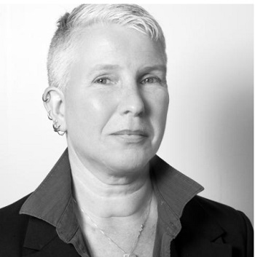
Either/or thinking
Binary:
Consequences of moving past binary:
Human/wildlife
Reconsider human/wildlife conflict
Humans embedded in ecosystems
Habitat is aquatic/terrestrial
And airspace (Diehl 2013)
conserve airspace
think about airspace niches
interactions among moving animals
Reflect: Examples from your research field/experience?
Cesar Estien –”A more intimate ecology”
Catriona Sandilands—”Queer Ecology”—1994
Notes:
Slide 19: We’ll end by thinking about how common ways of thought can influence our science. Either/or or binary thinking is common in western, White culture. Breaking through binaries can advance the fields of ecology and environmental studies. Here are two examples of binary thinking and how blurring the boundaries, or considering other options, can lead to scientific breakthroughs. Then you’ll have some time to reflect on any examples from your own research field or experience.
The first example is the human/wildlife boundary, studied by Cesar Estien. We often define boundaries between space for humans and space for wildlife, and describe human/wildlife conflict as instances when wildlife cross over that imagined boundary. When we blur this boundary, it might change the way that we think about human/wildlife conflict–can we even call it conflict any more? And it changes how we think about our role as humans, embedded in an ecosystem instead of apart from it.
The next example is the common conception of habitat as either aquatic or terrestrial. It wasn’t until recently that Robert Diehl considered a third option–airspace. This changes conservation–we now need to think about how to conserve airspace and migratory corridors. We might start to think about airspace niches, and how animals partition the vertical space above our heads in ways similar to marine systems. And we might start to think about interactions among animals in flight.
[Give students time to reflect on examples from their own field or experience, and think about what new scientific questions arise when the boundaries are blurred or other possibilities are added?]
Sources:
Sandilands, C. 1994. “Lavendar’s green? Some thoughts on queer(y)ing environmental politics.”
Estien, C. 2023. “A more intimate ecology: Reframing the relationship between the researcher
and the research(ed).” ecoevorxiv
https://www.sierraclub.org/sierra/what-is-queer-ecology
Diehl, RH. 2013. “The airspace is habitat.” Trends in Ecology & Evolution 28(7): 377-379.

Slide 20
Notes:
Slide 20: [If this lecture is part of a biology or ecology course, one suggestion is to give this lecture early on, and encourage students to apply this lens to the remaining lectures, thinking about how scientists’ identities influenced their science, providing feedback on how the lectures could be improved upon to better reflect the diversity of scientists in the field, etc. This will reinforce the students’ learning, allow them to be active participants in their education, and improve future iterations of the course.]

